Slide 1
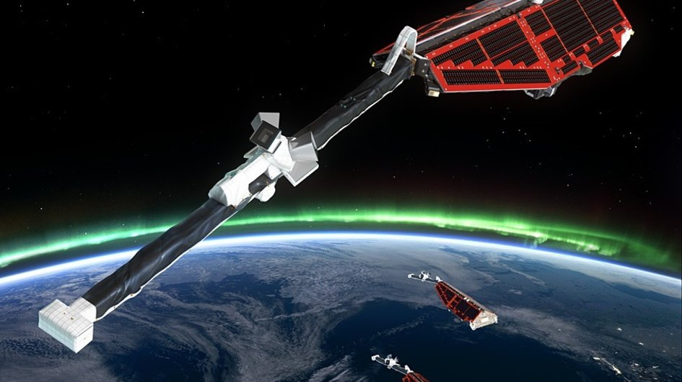

Detecting high-latitude ionospheric plasma irregularities by Swarm satellites
Yaqi Jin¹, Andres Spicher¹, Chao Xiong², Lasse Clausen¹, Claudia Stolle², Guram Kervalishvili², and Wojciech Miloch¹
University of Oslo, Department of Physics, Oslo, Norway.
Helmholtz Centre Potsdam, GFZ, Telegrafenberg, 14473 Potsdam, Germany.

Slide 2
Outline
1. Introduction to ionospheric irregularities
2. Swarm Datasets
3. Statistical result of high-latitude irregularities
4. Summary

Slide 3
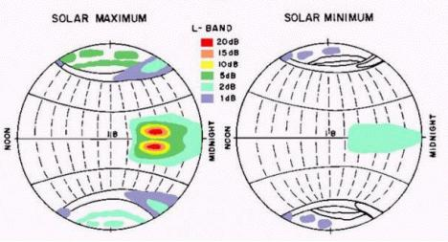
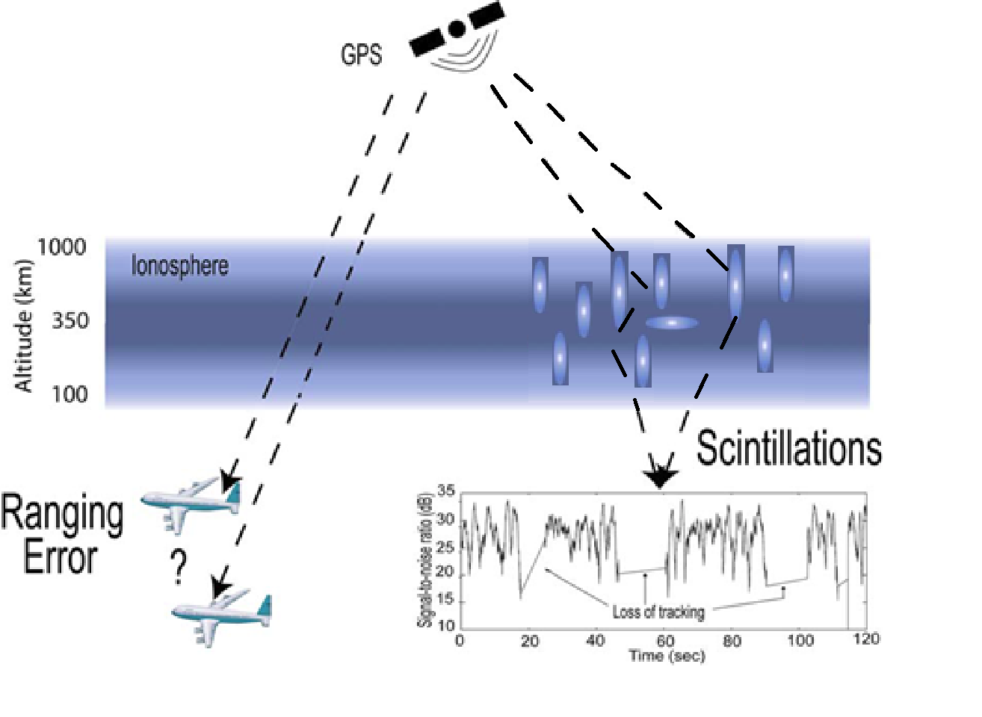
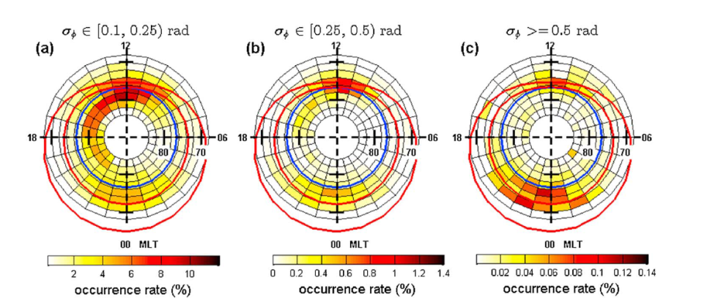
Introduction to ionospheric irregularities
(A)
(B)
A cartoon showing ionospheric effects on GPS signals. Adapted from “A Beginner’s Guide to Space Weather and GPS” by P. Kintner.
(A) The global morphology of ionospheric scintillation activity during solar maximum and solar minimum (Basu et al., 1988); (B) The MLAT/MLT distribution of GPS phase scintillations (Jin et al., 2015).

Slide 4
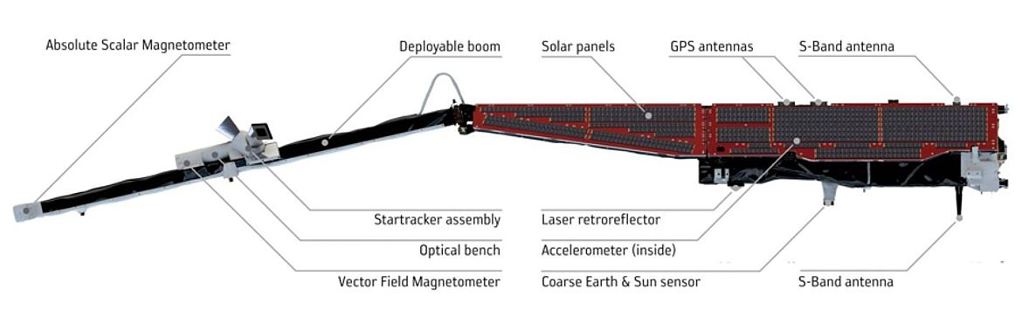
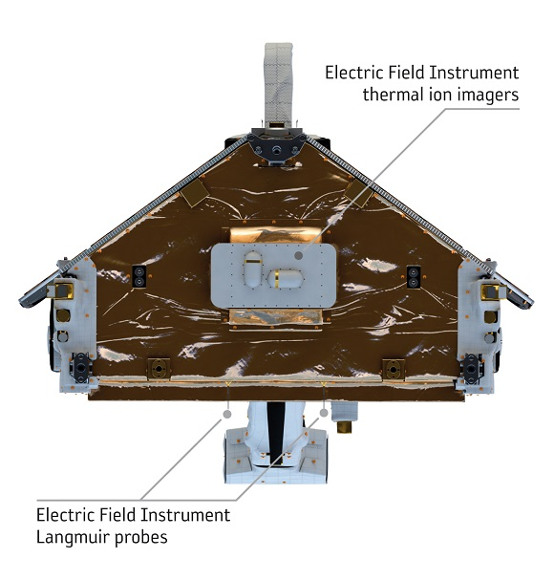
The IPIR concept
To develop a new high-level data product, the Ionospheric Plasma Irregularities (IPIR) product that can characterize
the ionospheric plasma irregularities and fluctuations by using measurements from Swarm satellites.
Swarm Datasets
Level 2 data, TECxTMS_2F: GPS TEC data, upon availability (data might also be derived from Level 1b (RINEX) GPSX_RO_1B data).
Level 1b Plasma products, EFIx_PL_1B, 2Hz data from EFI; mainly Ne, but also Te.
Level 2 data, IBIxTMS_2F: Ionospheric Bubble Index (IBI) for equatorial regions.
Polar Cap Products (PCP): detecting and characterizing polar cap patches in the polar caps.
Level 2 data, FACxTMS_2F: Field Aligned Current (FAC), for detecting the boundaries of auroral zones.
Other products: e.g., MAGx_LR_1B Product

Slide 5

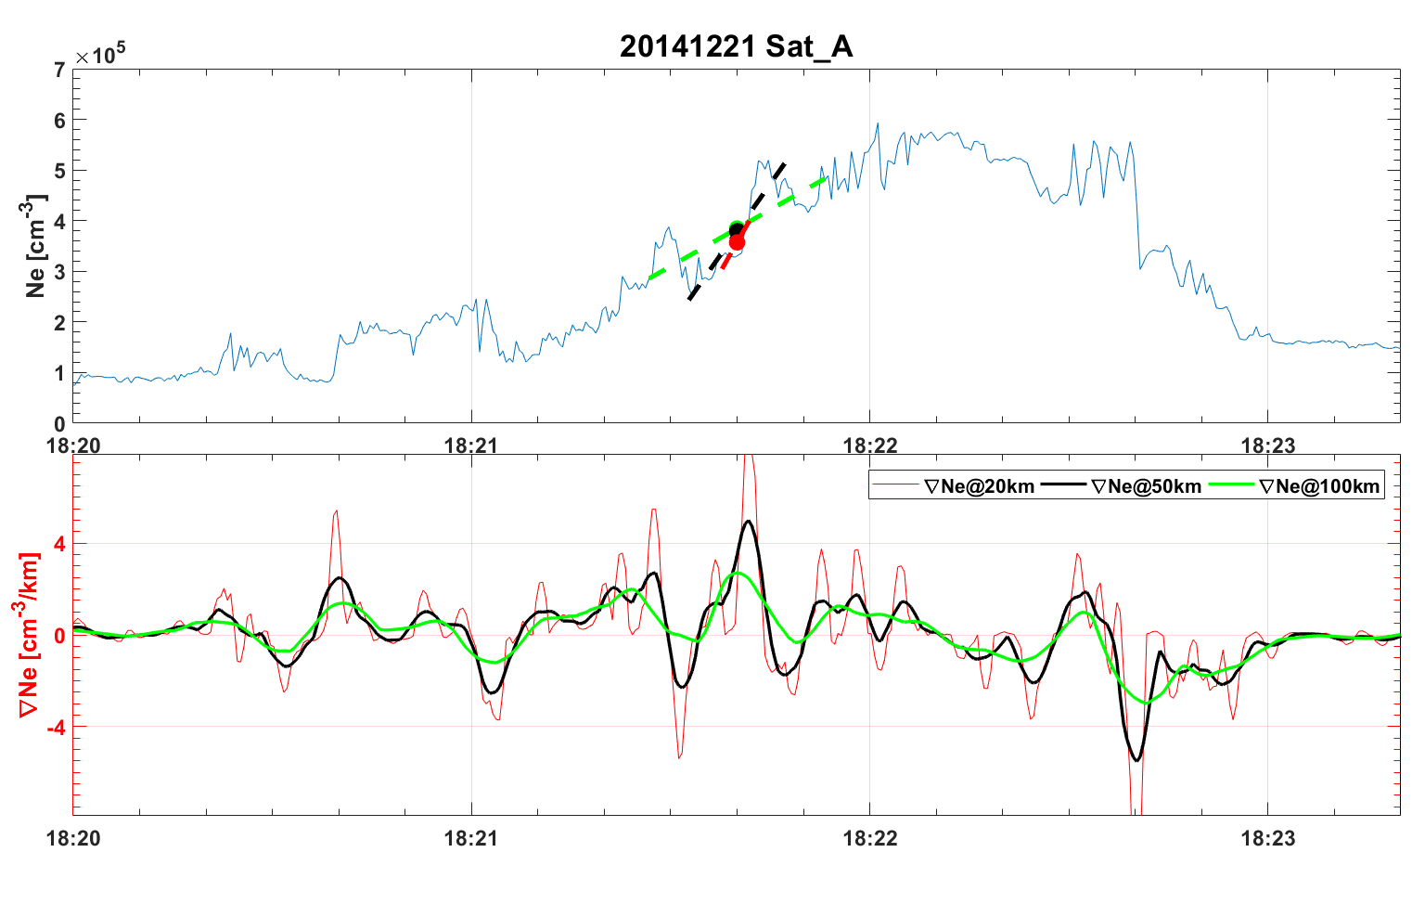
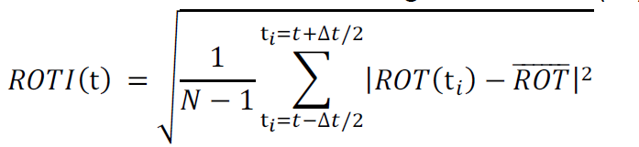

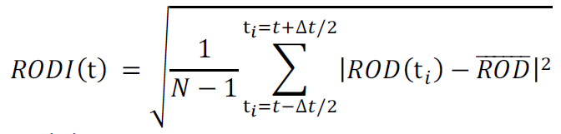
Irregularity parameters from Swarm
Many parameters can be derived from the Swarm datasets:
TEC onboard swarm (TEC, ROT, ROTI)
Density gradients…
An Example for calculating density gradients.
Langmiur probe (ROD, RODI)

Slide 6
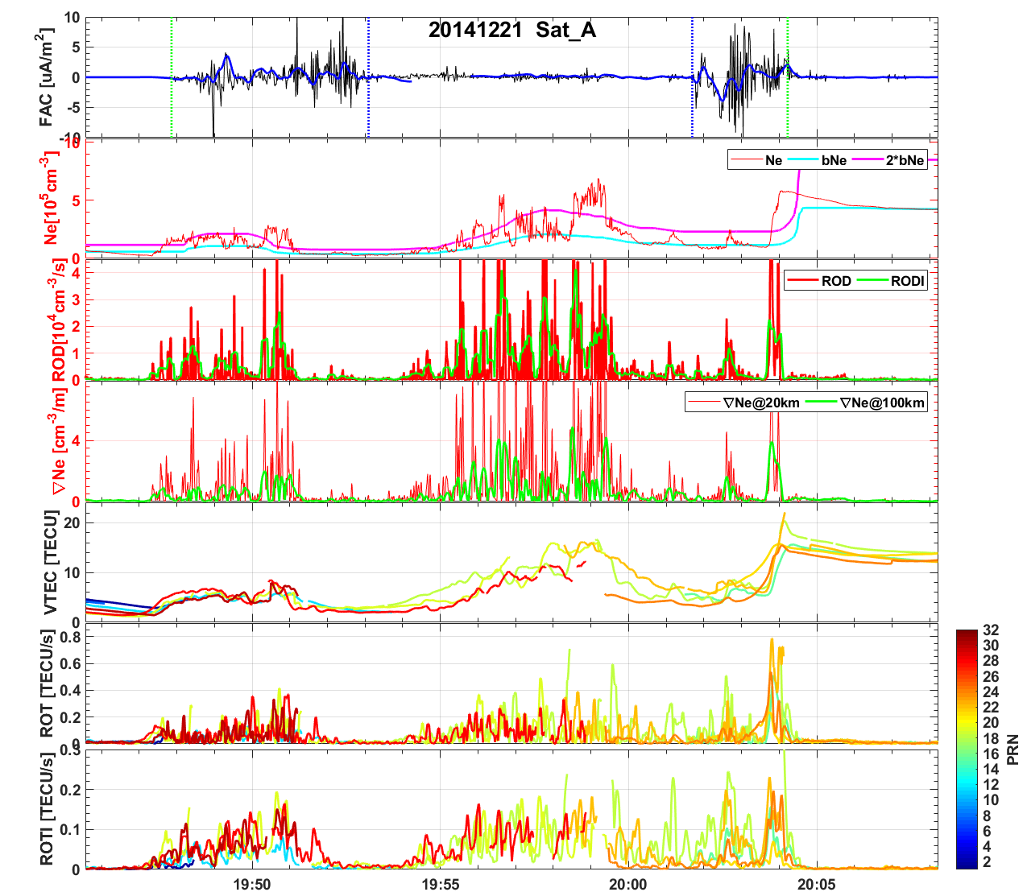
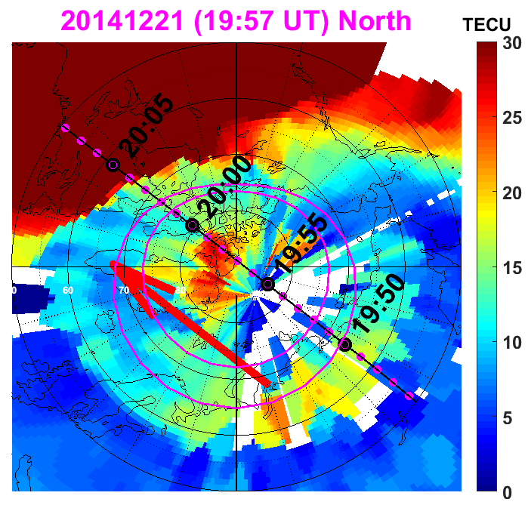
Typical observations at high latiutdes
GPS TEC map in MLAT/MLT coordinates.

Slide 7
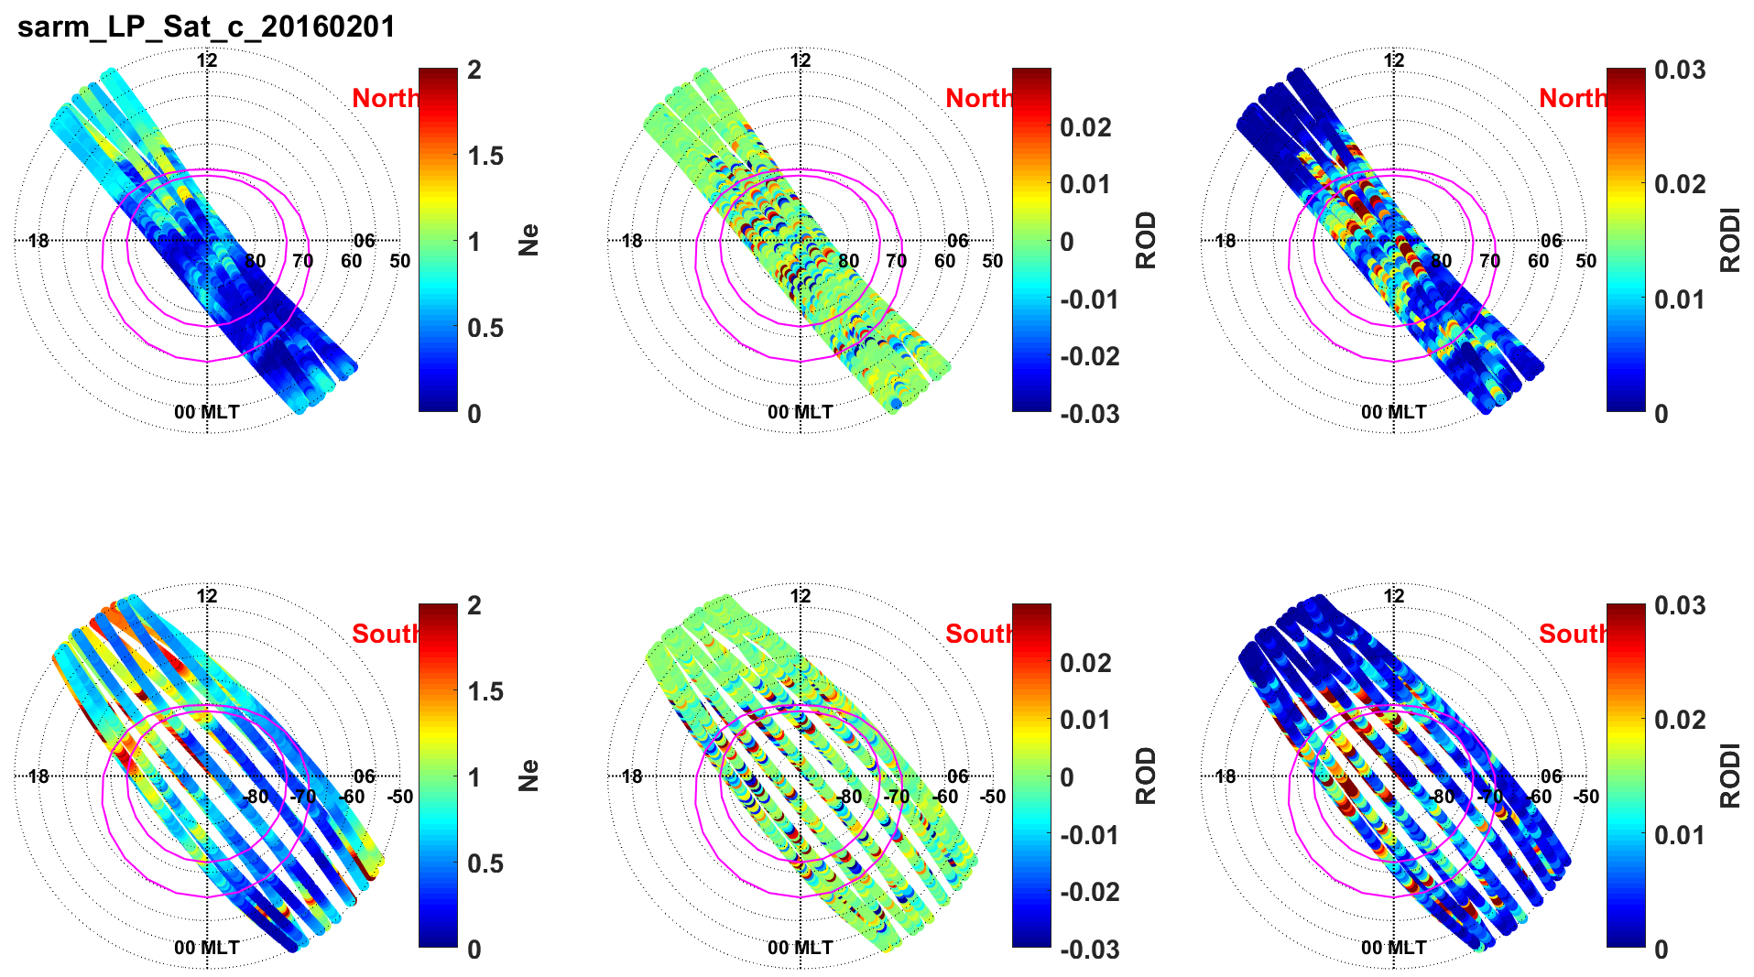
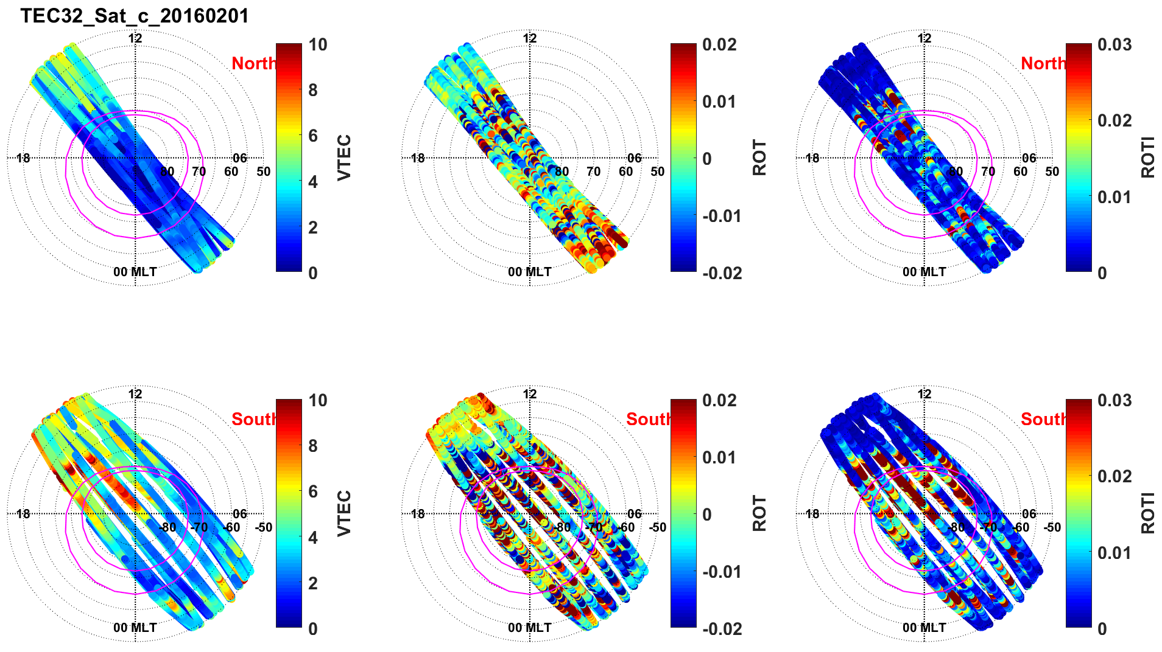
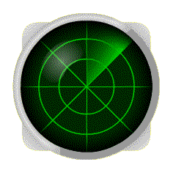
Ionospheric irregularities at high-latitudes
Swarm covers a certain MLT sector in each day
Langmuir Probe onboard Swarm A
GPS TEC onboard Swarm A
Like a radar scan

Slide 8
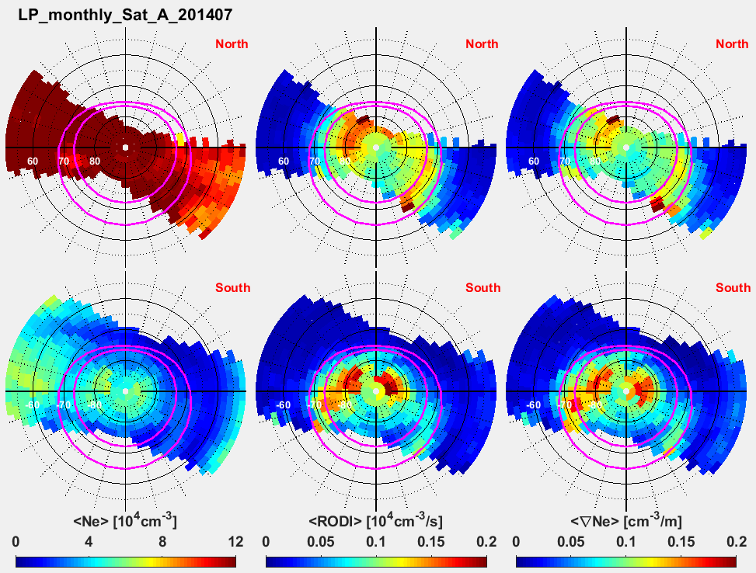
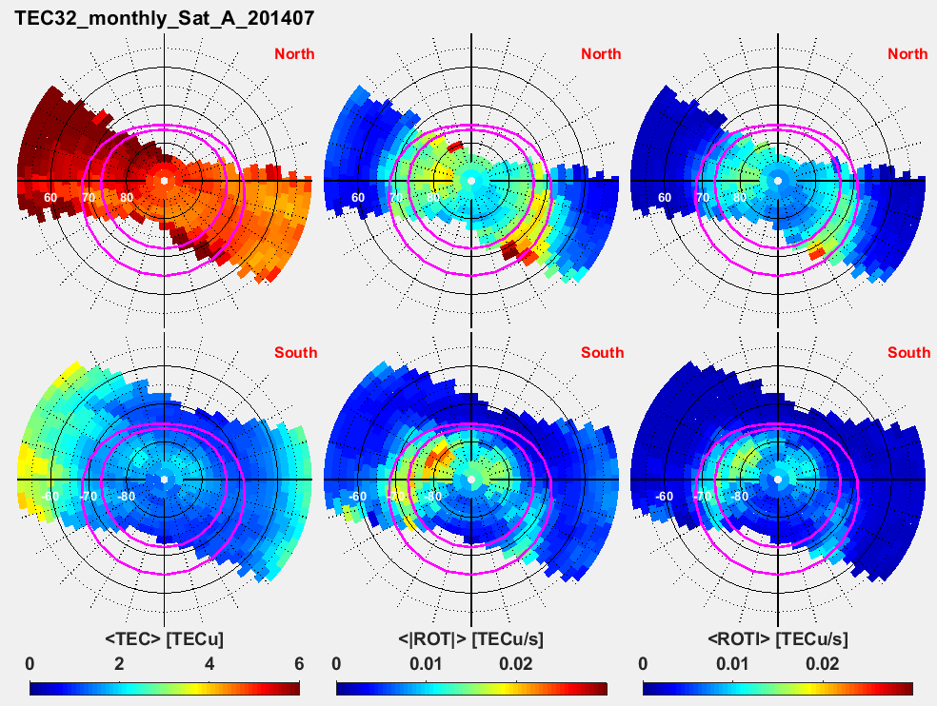
Monthly averages of ionospheric irregularities at high latitudes
Langmuir Probe onboard Swarm A
GPS onboard Swarm A

Slide 9
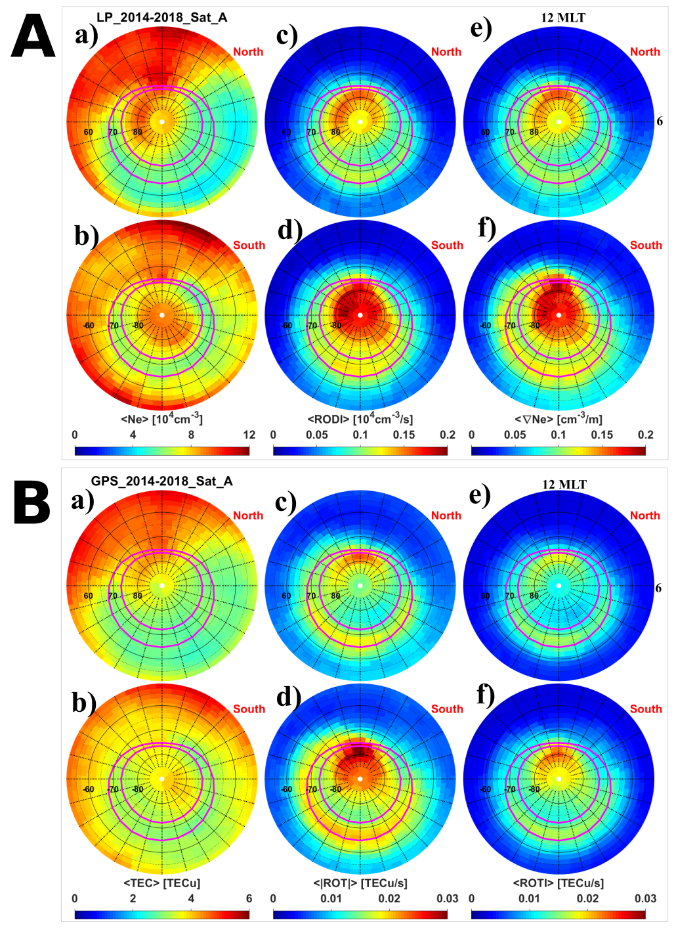
Climatology of irregularities at high latitudes
GPS onboard Swarm A
Langmuir Probe onboard Swarm A
In both hemispheres, Ne is higher at the dayside, Ne decreases gradually from dayside to nightside;
RODI and ∇Ne are higher in the dayside polar cap and decrease toward the nightside auroral oval;
ROT and ROTI are significant both in the dayside polar cap and along the auroral oval.

Slide 10
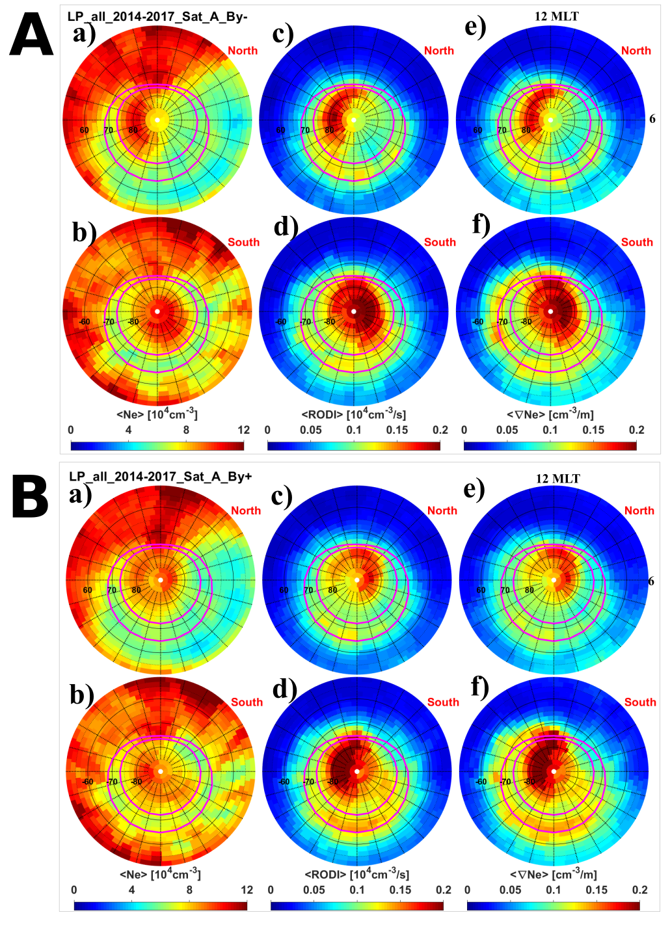
IMF By dependence of irregularities

Slide 11
Seasonal variations of ionospheric irregularities
GPS TEC and electron density show similar temporal variations.
Clear solar cycle variation.
Density shows similar variations versus local seasons.
Irregularity parameters behave differently versus local seasons.

Slide 12
Summary
Swarm can be used to characterize the global distributation of ionospheric irregularities.
Similarities and differences between TEC and Ne flucatuations at high latitudes:
The spatial distributions of Ne and TEC are similar.
RODI are more confined in the central polar cap, while ROTI are located both in the polar cap and along the auroral oval.
The spatial distributions of irregularities are dependent on the IMF By.
The irregularities show clear solar cycle and seasonal variations in both hemispheres.

Slide 13
THANK YOU!

